Slide 1
Digital Portfolio
STUDENT NAME: V. POOJA
REGISTER NO AND NMID: 24131061802522055 and autanm106106cs214035
DEPARTMENT: B. SC. COMPUTER SCIENCE ( Il YEAR )
COLLEGE:COLLEGE / UNIVERSITY : SHREE RAGHAVENDRA ART AND SCIENCE COLLEGE / ANNAMALAI UNIVERSITY

Slide 2
PROJECT TITLE
DIGITAL PORTFOLIO :
This project is a simple online portfolio for pooja. V The website introduces pooja,shows her skills (like Python, HTML, CSS, JavaScript, Java, C++), displays her certificates, and mentions
her interests in sports such as badminton and kho-kho.
KEY SECTION:
Introduction and CV download
About Me (education and interests)
Skills displayed with icons
Certificates with details
Sports interests
Contact information (GitHub, Linkedin, Email)
This portfolio is useful to share her profile, achievements, and contact details with others in
a modern and organized way.

Slide 3


AGENDA
Problem Statement
Project Overview
End Users
Tools and Technologies
Portfolio design and Layout
Features and Functionality
Results and Screenshots
Conclusion
Github Link
3/21/2024 Annual Review

Slide 4

PROBLEM STATEMENT
Students often struggle to present their skills, achievements, and projects in a professional manner.
Traditional resumes are static and lack interactivity.
A personal portfolio-website helps in showcasing technical skills, certificates, and extracurricular activities dynamically, increasing opportunities for internships and jobs.

Slide 5

PROJECT OVERVIEW
This project is a personal portfolio website developed for pooja. V
It highlights education, skills, certificates, extra curricular achievements, and contact information in an interactive and visually appealing design.
The portfolio is fully responsive and deployed on GitHub Pages for public access

Slide 6

WHO ARE THE END USERS?
Recruiters To evaluate skills, certificates, and academic achievements
Faculty/College evaluators → For project assessment and showcasing student achievements
Peers and collaborators To connect and collaborate on projects
General audience - To know about pooja`s journey and capabilities.

Slide 7

TOOLS AND TECHNIQUES
Frontend Framework: React.js
Styling : CSS, animations
Other Libraries: react-icons, typed.js, AOS animations
Version Control: Git & GitHub
Deployment: GitHub Pages
Design Tools: Canva / Figma for layout inspiration

Slide 8
POTFOLIO DESIGN AND LAYOUT
The portfolio follows a modern single-page scrolling layout with sections:
Home (Hero)-> Animated introduction with glowing effects and profile photo.
About-> introduction, education details, and career goal.
Skills-> Display of technical skills with logos and animations.
Certificates-> Achievements displayed.
Sports->Section highlighting extracurricular activities with images.
Contact->Direct links to email, GitHub, and Linkedin.
Footer-> Clean copyright and quick links.
8

Slide 9
FEATURES AND FUNCTIONALITY
Animated typing effect for introduction.
Floating glowing decorations for modern design.
Profile photo with animated circular border.
Certificates displayed as cards with pop-up view and download option
Sports achievements showcased with images and descriptions.
Smooth scroll navigation with navbar.
Fully responsive (works on desktop and mobile).

Slide 10

RESULTS AND SCREENSHOTS
I’mpooja. V. R an enthusiastic student currently pursuing my B.Sc.in Computer Science at Shree Raghavendra Arts and Science college Chidambharam. With a strong passion for technology and problem-solving. I have been developing my skills in Python, C++, Java, Js and Css. Along with my academics. I have earned certifications including IBM Web Development Fundamentals. As well as a Certificate of essay writing Compitation. Beyond coding, I actively take part in sports such as badminton, kabhadi and kho-kho, which keep me energetic, motivated, and disciplined. My ultimate goalis to grow as a developer,gain real-world experience through internships and collaborations and contribute to impactful project with curiority dedication and a love for continuous learning. I'm exited to being my journey in the tech industry and explore new opportunities ahead.
3/21/2024 Annual Review
10

Slide 11
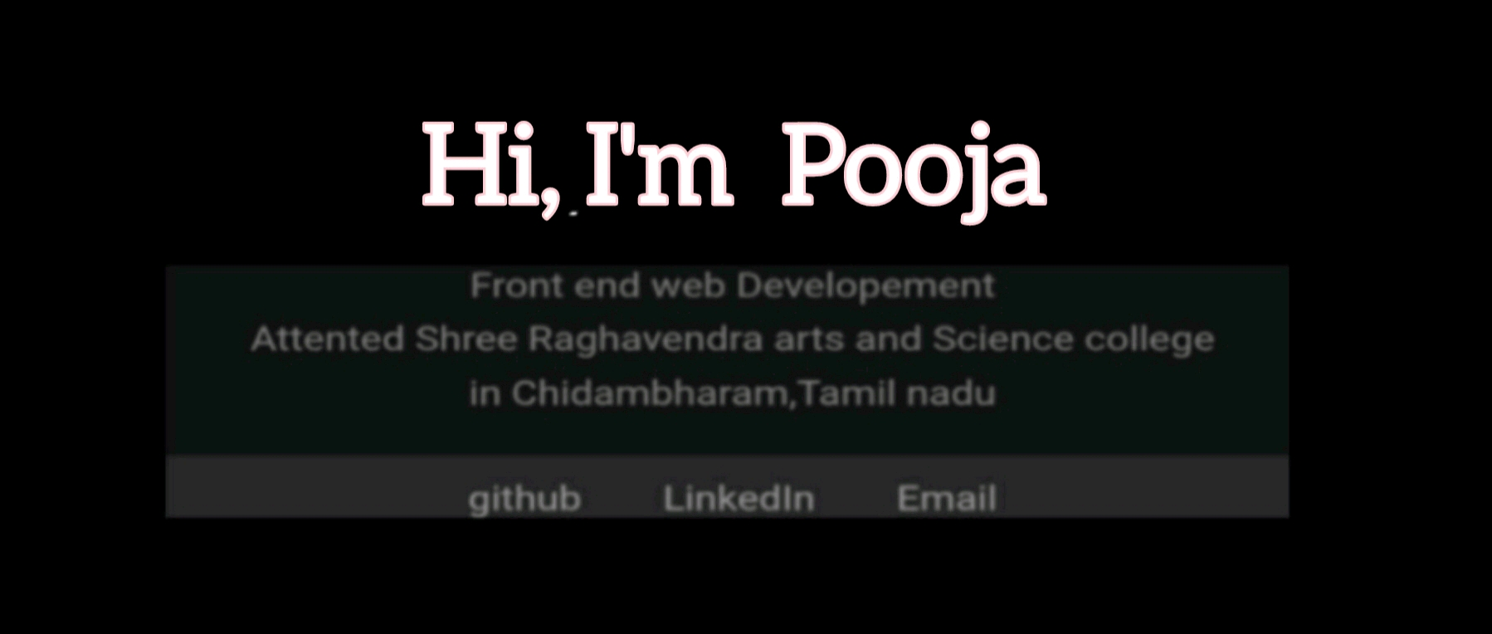
RESULTS AND SCREENSHOTS
Results and screen Shot

Slide 12
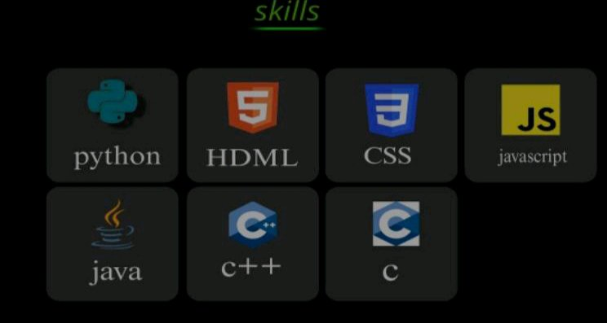
RESULTS AND SCREENSHOTS

Slide 13
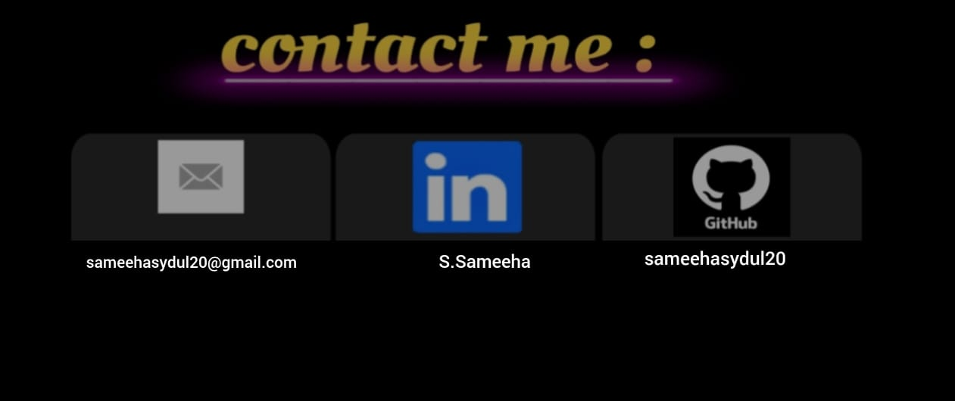
RESULTS AND SCREENSHOTS

Slide 14
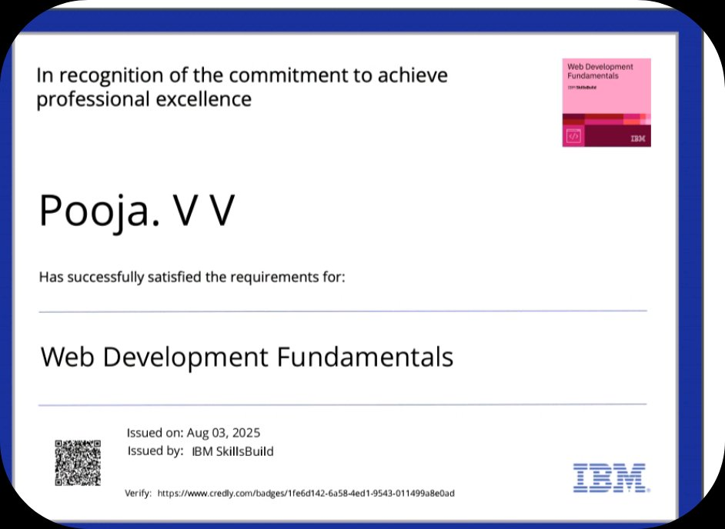
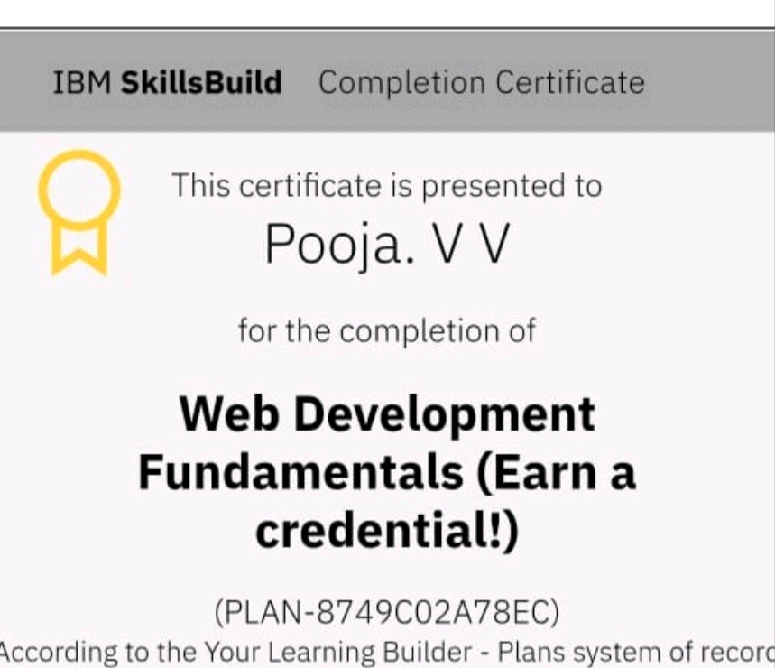
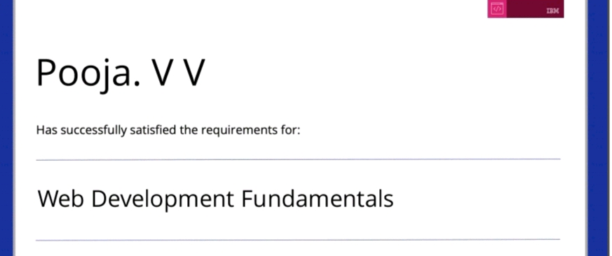
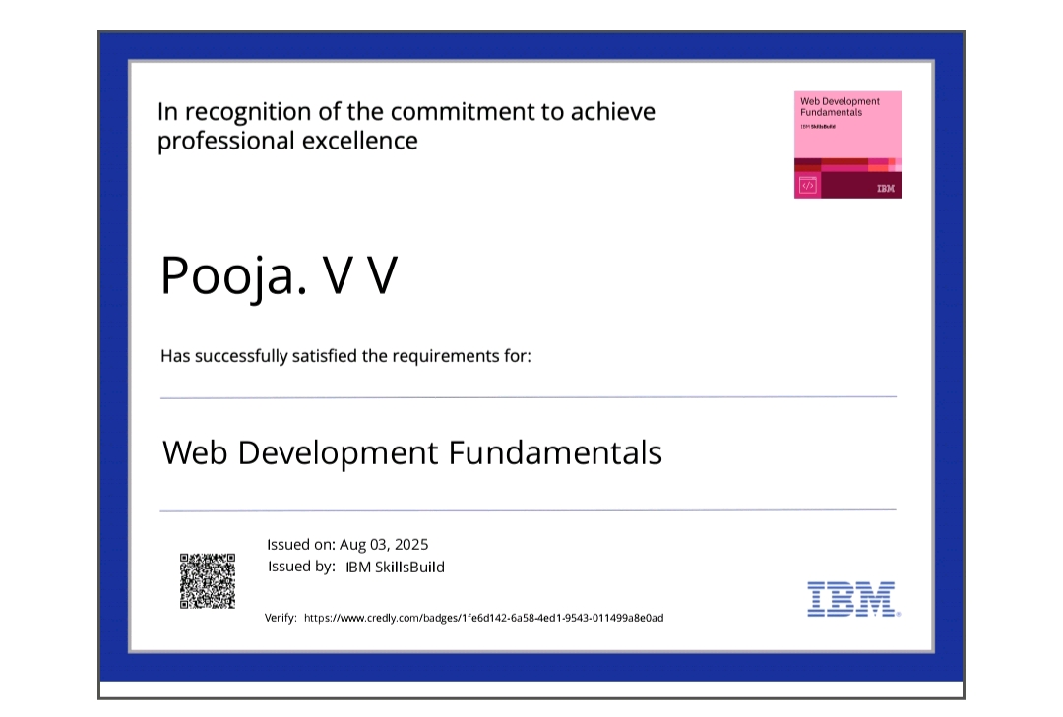
CERTIFICATES
RESULTS AND SCREENSHOTS
GITHUB LINK

Slide 15
GITHUB LINK
https://github.com/sameehasydul20-code

Slide 16
CONCLUSION
The project demonstrates how a student can transform a static resume into a dynamic portfolio website. It serves as a platform to showcase technical skilis, achievements, and extracurricular activities in a modem, imerective format. This portfolio will help Sameeha in her academic growth, imemships, and job opportunities
16

